Slide 1
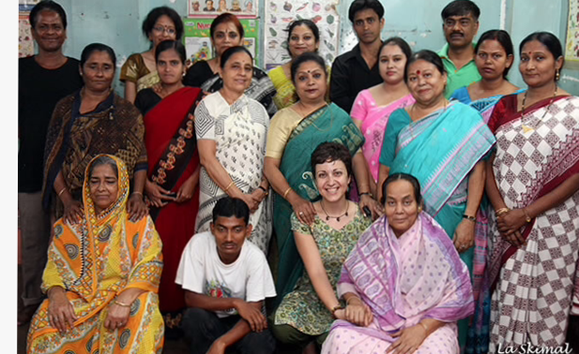
Founder, teachers and other support staff

Slide 2
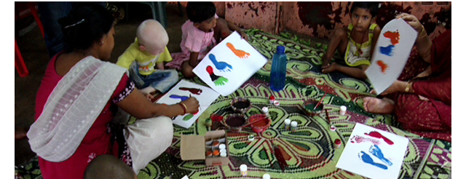
Art and craft session

Slide 3
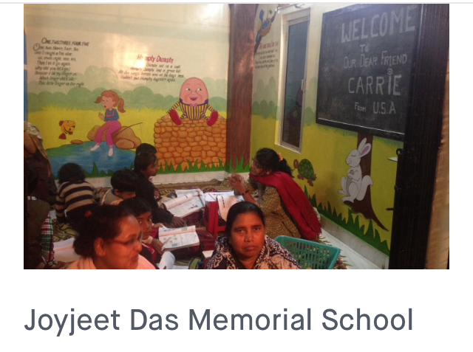
Evening class in progress

Slide 4
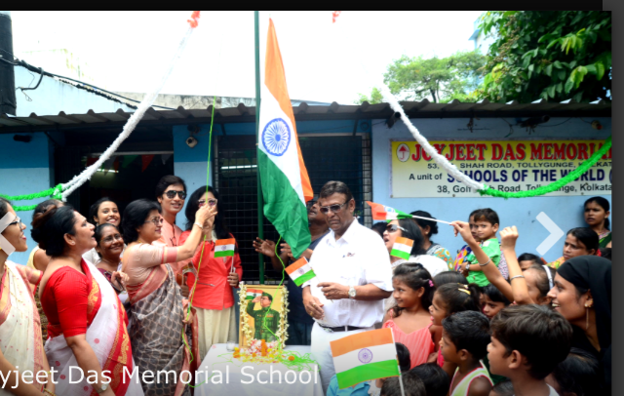
Independence Day Celebration, 2017

Slide 5
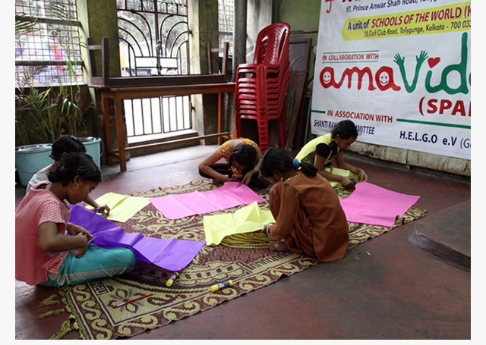
Weekend Art and craft class

Slide 6
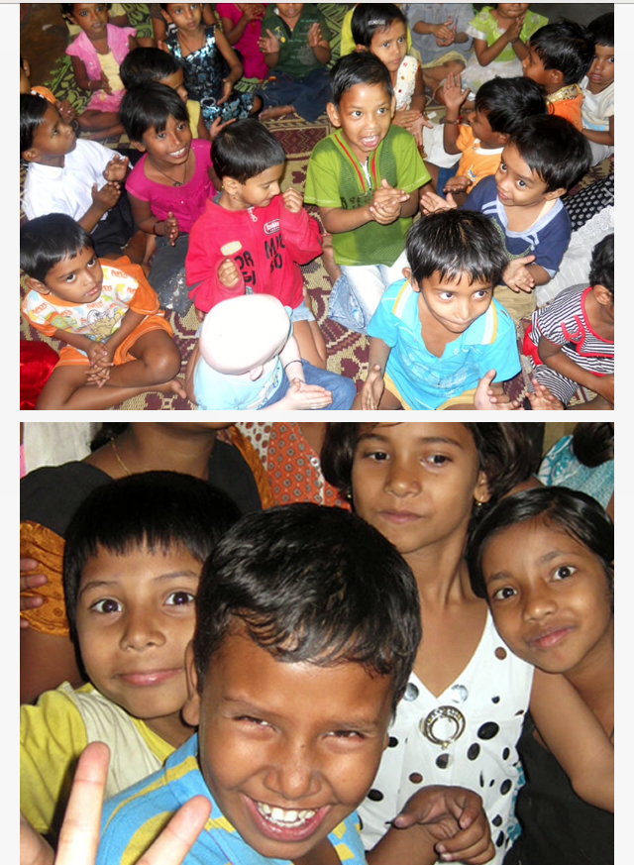
We are the future…

Slide 7
THANK YOU

