Slide 1
Pedagogy of Teaching-Learning and its Application in Classroom

Slide 2
Concept of Pedagogy:
Pedagogy (/ˈpɛdəɡɒdʒi/, /ˈpɛdəɡoʊdʒi/, or /ˈpɛdəɡɒɡi/) (most commonly understood as the approach to teaching) refers more broadly to the theory and practice of education, and how this influences the growth of learners. Pedagogy, taken as an academic discipline, is the study of how knowledge and skills are exchanged in an educational context, and it considers the interactions that take place during learning. Pedagogies vary greatly, as they reflect the different social, political, cultural contexts from which they emerge.^{[1]} Pedagogy is the act of teaching. ^{[2]} Theories of pedagogy increasingly identify the student as an agent, and the teacher as a facilitator. Conventional western pedagogies, however, view the teacher as knowledge holder and student as the recipient of knowledge (described by Paulo Freire as "banking methods"^{[3]}). Pedagogy, literally translated, is the art or science of teaching children. The word comes from the ancient Greek paidagogos, a compound comprised of "paidos" (child) and "agogos" (leader).

Slide 3
Teaching – Learning of 3R’s:
The phrase "the Three Rs" may have originated in a speech made by Sir William Curtis in 1795. but this origination is disputed in the publication The Mirror of Literature, Amusement, and Instruction, Volume 5.^{[4][5]} An extended modern version of the three Rs consists of the "functional skills of literacy, numeracy and ICT".^{[6]}
There is an earlier reference to the skills of reading, writing, and arithmetic in St Augustine's Confessions (c. 397-401), though of course the words do not begin with 'R' in Latin

Slide 4
Teaching – Learning of Verbal Conditioning:
The individual is constantly engaged in acquiring, assimilating, and manipulating words and symbols. An analysis of the individual's verbal behavior provides one with clues for the understanding of his thoughts, enduring attitudes, and temperamental characteristics. The knowledge obtained from such analysis can be subsequently utilized in predicting his future course of action. Thus, a proper study of man should begin with man's verbal output. The symbols are verbal and are expressed through speech that allows them to be easily manipulated. However, the vocal characteristics of languages are of secondary importance. The basic element of speech is the word. Phonemes are the basic sound elements of a word, but are not the significant elements of speech. Verbal conditioned responses (CRs) are not only adaptive responses, but serve to change the conditions under which they occur.

Slide 5
Teaching – Learning of Psychomotor Skill:
Psychomotor learning is the relationship between cognitive functions and physical movement. Psychomotor learning is demonstrated by physical skills such as movement, coordination, manipulation, dexterity, grace, strength, speed—actions which demonstrate the fine or gross motor skills, such as use of precision instruments or tools, and walking.
Behavioral examples include driving a car, throwing a ball, and playing a musical instrument. In psychomotor learning research, attention is given to the learning of coordinated activity involving the arms, hands, fingers, and feet, while verbal processes are not emphasized.^{[1]}
Stages of psychomotor development:
According to Paul Fitts and Michael Posner's three-stage model, when learning psychomotor skills, individuals progress through the cognitive stages, the associative stage, and the autonomic stage.^{[2]} The cognitive stage is marked by awkward slow and choppy movements that the learner tries to control. The learner has to think about each movement before attempting it. In the associative stage, the learner spends less time thinking about every detail, however, the movements are still not a permanent part of the brain. In the autonomic stage, the learner can refine the skill through practice, but no longer needs to think about the movement.
Cont…….

Slide 6
Factors affecting psychomotor skills:
Psychological feedback
Amount of practice
Task complexity
Work distribution
Motive-incentive conditions
Environmental factors

Slide 7
Teaching – Learning of Principles and Concept:
Educational psychologists and pedagogues have identified several principles of learning, also referred to as laws of learning, which seem generally applicable to the learning process. These principles have been discovered, tested, and used in practical situations. They provide additional insight into what makes people learn most effectively. Edward Thorndike developed the first three "Laws of learning:" readiness, exercise, and effect.
Concept learning, also known as category learning, concept attainment, and concept formation, is defined by Bruner, Goodnow, & Austin (1967) as "the search for and listing of attributes that can be used to distinguish exemplars from non exemplars of various categories". More simply put, concepts are the mental categories that help us classify objects, events, or ideas, building on the understanding that each object, event, or idea has a set of common relevant features. Thus, concept learning is a strategy which requires a learner to compare and contrast groups or categories that contain concept-relevant features with groups or categories that do not contain concept-relevant features.
Cont……….

Slide 8
Concept Learning: Inferring a Boolean-valued function from training examples of its input and output.
A concept is an idea of something formed by combining all its features or attributes which construct the given concept. Every concept has two components:
Attributes: features that one must look for to decide whether a data instance is a positive one of the concept.
A rule: denotes what conjunction of constraints on the attributes will qualify as a positive instance of the concept.
Types of Concept:
Concrete or Perceptual Concepts vs Abstract Concepts
Defined (or Relational) and Associated Concepts
Complex Concepts
Methods of Learning a Concept:
Discovery
Examples
Words
Exemplars comparison and contrast

Slide 9
Teaching – Learning of Problem Solving:
Problem-based learning (PBL) is a student-centered pedagogy in which students learn about a subject through the experience of solving an open-ended problem found in trigger material. The PBL process does not focus on problem solving with a defined solution, but it allows for the development of other desirable skills and attributes. This includes knowledge acquisition, enhanced group collaboration and communication. The PBL process was developed for medical education and has since been broadened in applications for other programs of learning. The process allows for learners to develop skills used for their future practice. It enhances critical appraisal, literature retrieval and encourages ongoing learning within a team environment.

Slide 10
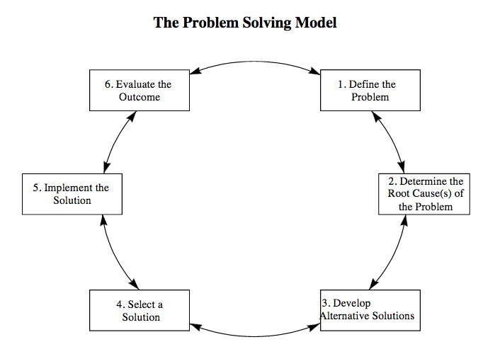
Steps of Problem Solving:

Slide 11
Advantages and Dis Advantages of Problem Solving:
Fosters Student Centered learning
Upholds lifelong learning
In-depth learning
Self learning
Better understanding
Self motivated
Higher level of Learning
Enhance teacher – student relationship
Disadvantages:
Time consuming
Traditional assumptions of the students
Cognitive load
Role of instructor
Not easy to implement

Slide 12
Teaching – Learning of Knowledge Construction:
Learning is the process of creating and constructing knowledge and some individuals’ learning may occur in educational system. As students try to improve their learning, they take part in the learning-teaching process. Students’ learning in school is intentionally designed to monitor their learning and this process is called the learning-teaching process. Learning-teaching process operates by means of interaction between students, teachers and knowledge. Students and teachers don’t have sufficient time to create and construct knowledge in the learning-teaching process and teachers mostly transmit and distribute ready-made knowledge in this process. Thus, students must follow their teachers’ plans and other education policy-makers who decide what type of knowledge and experiences are important for students’ learning. Creating and constructing knowledge cannot be the primary aims for them in the formal learning-teaching system. However, the creation and construction of knowledge must be the main issues in the learning-teaching process. For this reason, this paper aims at discussing the construction and reconstruction of knowledge in learning-teaching process based on phenomenological approach in education.

Slide 13
Principles of Knowledge Construction:
Aim to make learners understand a few key ideas in-depth manner, rather than taking up so many topics superficially.
Give varied examples.
Provide opportunities for experimentation.
Provide lots of opportunities for quality interaction.
Have lots of hands-on activities.
Relate your topic to real life situations..
Do not depend on the explanation method all the time.

