Slide 1
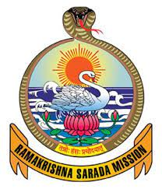
RAMAKRISHNA SARADA MISSION VIVEKANANDA VIDYABHAVAN
Presented by>>>>>Mousumi Mukherjee
Department of Human Rights
State Aided College Teacher

Slide 2
classification of human rights

Slide 3
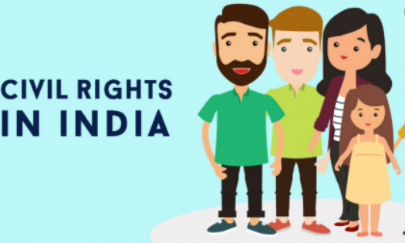
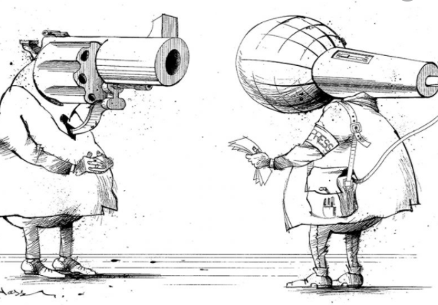
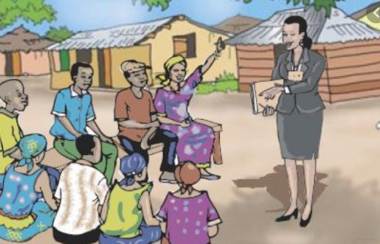
Types of Human Rights
Individual (civil) rights
Rule of law
Rights of political expression
Economic and social rights
Rights of communities

Slide 4
Individual (civil) rights
life, liberty, and security of the person; privacy and freedom
of movement; ownership of property; freedom of thought, conscience, and religious belief and practice; prohibition of slavery, torture, and cruel or degrading punishment.

Slide 5
Rule of law
equal recognition before the law and equal protection of
the law; effective legal remedy for violation of rights;
impartial hearing and trial; presumption of innocence; and prohibition of arbitrary arrest.

Slide 6
Rights of political expression
freedom of expression, assembly, and association; the right to take part in government; and periodic and meaningful elections with universal and equal suffrage.

Slide 7
Economic and social rights
An adequate standard of living; free choice of employment; protection against unemployment; "just and favorable remuneration"; the right to form and join trade unions; "reasonable limitation of working hours"; free elementary education; social security; and the "highest attainable standard of physical and mental health."

Slide 8
Rights of communities
self-determination and protection of minority cultures.

Slide 10
The division of human rights into three generations was initially proposed in 1979
by the Czech jurist Karel Vasak
at the International Institute of Human Rights in Strasbourg.
He used the term at least as early as November 1977.
Vasak's theories have primarily taken root in European law.

Slide 11
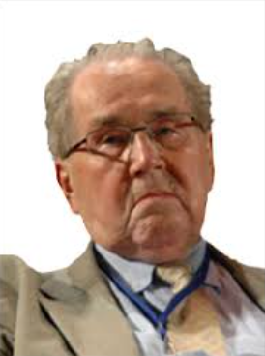
Karel Vasak

Slide 12
Three Generations (Phases) of Human Rights Philosophy
Enlightenment (17th-18th Century)
Socialist tradition (19th century)
The third generation of "solidarity rights" (20th century)

Slide 13
Enlightenment (17th-18th Century)
The first tier or "generation" consists of civil and political rights and derives primarily from the seventeenth and eighteenth-century political theories noted earlier which are associated with the English, American, and French revolutions. Think "life, liberty, and the pursuit of happiness." This approach favors limiting government by placing restrictions on state action. The rights set forth in Articles 2-21 of the Universal Declaration of Human Rights include: freedom from discrimination; freedom from slavery; freedom from torture and from cruel, inhuman, or degrading treatment; freedom from arbitrary arrest and detention; the right to a fair and public trial; freedom of thought, conscience, and religion; freedom of opinion and expression; and the right to participate in government through free elections.

Slide 14
Socialist tradition (19th century)
The second generation of rights broadens the primarily political focus of of earlier views to include economic, social, and cultural rights. This view originates primarily in the socialist traditions of Marx and Lenin. According to this view, rights are conceived more in positive rather than negative terms, and thus encourage the intervention of the state. Illustrative of these rights are Articles 22-27 of the Universal Declaration of Human Rights. They include the right to social security; the right to work; the right to a standard of living adequate for the health and well-being of self and family; and the right to education.

Slide 15
The third generation of "solidarity rights" (20th century)
These views are a product of the rise and decline of the nation-state in the last half of the twentieth century. These rights have been championed by the Third World and remain some what controversial and debated. The specific rights include the right to political, economic, social, and cultural self-determination; the right to economic and social development; and the right to participate in and benefit from "the common heritage of mankind.“

Slide 16
Generations of Human Rights
First Generation
Second Generation
Third Generation

Slide 17
First Generation
The first generation of human rights are based on the principles of individualism and non-interference
they tend to be “negative” rights, based on the Anglo-American principles of liberty.
This first generation of rights developed under a strong mistrust of government
since evolved into what are now known as “civil” or political” rights.
First-generation human rights, often called "blue" rights, deal essentially with liberty and participation in political life. They are fundamentally civil and political in nature.

Slide 18
1) The right to life
2) The right to property
3) The right to be seen equal before the law
4) The right to receive a fair and public hearing where one is innocent before proven guilty
5) The right to privacy at home
6) The right to move and reside anywhere within one’s country
7) The right to seek asylum internationally
8) The right to marry and found a family
9) The right of freedom of belief and religion
10) The right of freedom of speech and opinion
11) The right to peacefully assemble and associate
12) The right to take part in the government directly or indirectly
13) The right to periodic and genuine elections
14) The right to have free choice of employment
15) The right to be protected from compulsion to join an organization
16) The right to be protected against slavery
17) The right to be protected against torture and cruel punishment
18) The right to be protected against arbitrary exile or arrest
19) The right as a parent to choose the type of education for your child
20) The right to hold ownership over any scientific, literary, or artistic production one creates

Slide 19
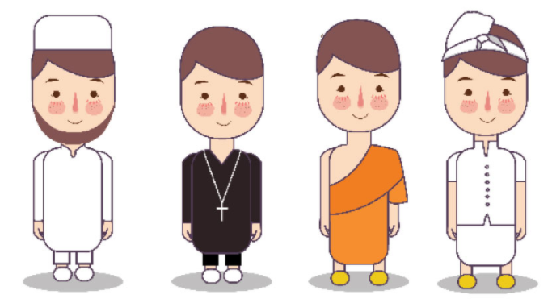
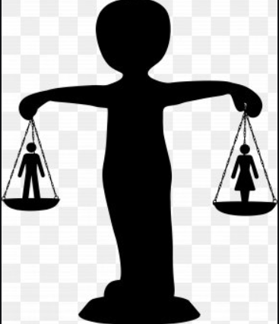
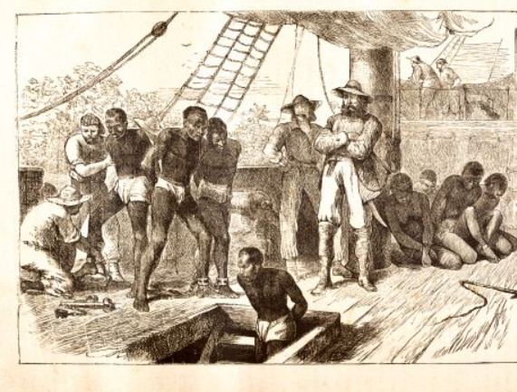

Slide 20
Second Generation
The International Covenant on Economic, Social, and Cultural Rights and Articles 22 through 27 of the UDHR focus on these rights.
often resisted by western nations during the Cold War, as they were perceived as “socialist notions
based on establishing equal conditions
The second generation of human rights are based on the principles of social justice and public obligation.
tend to be “positive” rights, based on continental European conceptions of liberty as equality.
This generation of human rights developed through those who had a strong desire for the state to provide protection for its neediest inhabitants via providing relief to the less fortunate.
This second generation of rights has since evolved into what are now known as “social” or “economic” rights.

Slide 21
The right to just and favorable conditions of work
The right of protection against unemployment
The right to equal work for equal pay
The right to rest and leisure as an employee
The right to reasonable limitation of working hours and periodic paid holidays
The right to free elementary education
The right to higher education equally accessible to all via merit
The right to education which promotes tolerance and understanding
The right to food, clothing, housing, medical care, and necessary social services
The right to security in the event of unemployment, sickness, disability, widowhood, old age
The right to special care and assistance for mothers and children
The right to enjoy remuneration and standards of living adequate for the health, well-being, and dignity of citizens and their families

Slide 23
Negative & Positive Rights
Impose duties on people and the state not to interfere with the action of the person
in the form of abuse
to avoid negating some actions and properties of the rights holders.
Negative liberty is the absence of obstacles, barriers or constraints
Impose affirmative duties on others to take particular action
provide some benefit to the rights holder.
Positive liberty is the possibility of acting — or the fact of acting — in such a way as to take control of one's life and realize one's fundamental purposes
positive rights are often guaranteed by other laws, and the majority of liberal democracies provide their citizens with publicly funded education, health care, social security and unemployment benefits.

Slide 24
Third Generation
The third generation of human rights is the most recent and vague in content.
Collective rights that belong to this group were mentioned in the Stockholm Declaration (UN General Assembly 1972), Rio Declaration (UN General Assembly 1992), and
other international documents of declaratory character.
Those rights include right to
self-determination, economic and social development, healthy environment, natural
resources, and participation in cultural heritage (Vašák 1977, p. 29). Hence, such rights
are positive and collective and demand responsibility, which lies beyond the nation-
solidarity rights-can not be exerted only by an individual, but only collectively,

Slide 25
The right of people to self-determination
The right to peace;
The right to development
The right to humanitarian assistance
Environmental law
The right of sexual minorities, ethnic, religious, linguistic, etc

Slide 27
Major approaches to human rights categorization:
(1)Negative (first generation) and Positive (second and third generations),
(2) Individual(first and second generations) and Collective (third generation), and
(3) National (first and second generations) and International (third generation)

Slide 28
Fourth Generation of Human Rights

