Slide 1
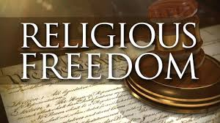
FREEDOM OF RELIGION
MOUMITA DE
RAMAKRISHNA SARADA MISSION VIVEKANANDA VIDYABHAVAN

Slide 2
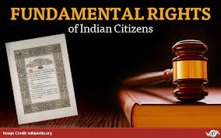
FUNDAMENTAL RIGHTS
The Fundamental Rights were included in the constitution because they were considered essential for the development of the personality of every individual and to preserve human dignity.
Part III of the Indian Constitution talks about Fundamental rights.

Slide 3
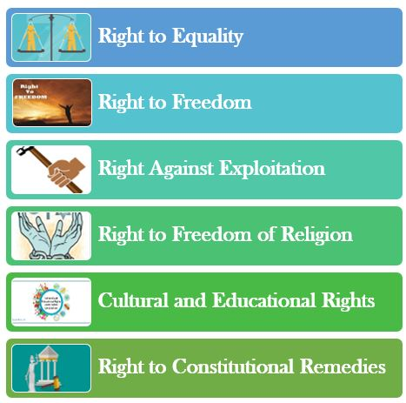
SIX FUNDAMENTAL RIGHTS
ARTICLE 14-18
ARTICLE 19-22
ARTICLE 23-24
ARTICLE 25-28
ARTICLE 29-30
ARTICLE 32

Slide 4
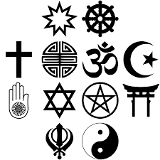
FREEDOM OF RELIGION
Freedom of religion is a principle that supports the freedom of an individual or community, in public or private, to manifest religion or belief in teaching, practice, worship, and observance. It also includes the freedom to change one's religion or beliefs.
Fundamental Rights guaranteed by Article 25-28 of the Constitution of India. Modern India came into existence in 1947 and the Indian constitution's preamble was amended in 1976 to state that India is a Secular state

Slide 5
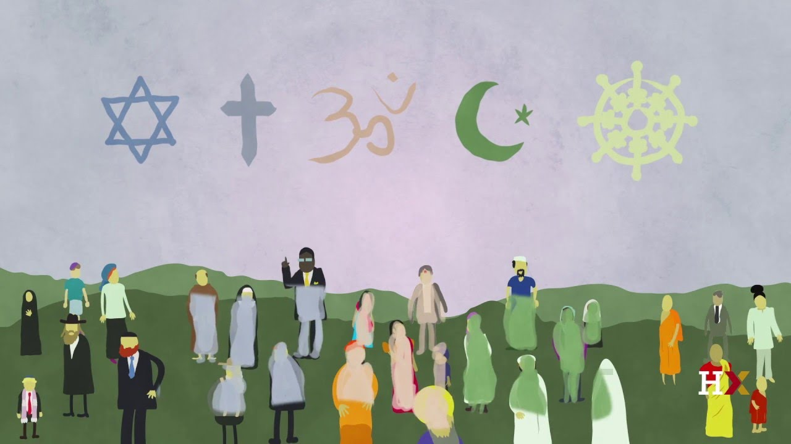
WHAT IS RELIGION
Religion is a social-cultural system of designated behaviors and practices, morals, worldviews, texts, sanctified places, prophecies, ethics, or organizations, that relates humanity to supernatural, transcendental, or spiritual elements. However, there is no scholarly consensus over what precisely constitutes a religion.

Slide 6

ARTICLE 25
FREEDOM OF CONSCIENCE ,PROFESSION,PRACTICE AND PROPAGATION OF RELIGION - Article 25 says "all persons are equally entitled to freedom of conscience and the right to freely profess, practice, and propagate religion subject to public order, morality and health

Slide 7
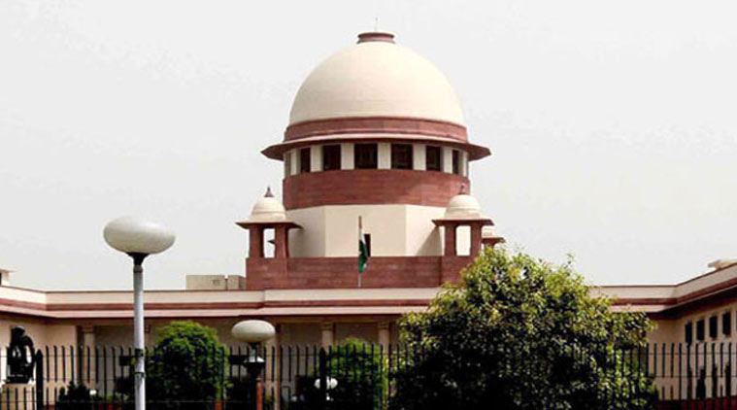
LANDMARK JUDGEMENT
In BIJOE EMMANUEL vs STATE OF KERALA ,The Supreme Court went to the extent of holding that Article 25 is an article of faith in the constitution recognizing the principle that real test of true democracy is the democracy is the ability of even an insignificant minority to find its identity under the countries constitution. It further observed that the question is not whether a particular religious belief or practice appeals to our reasons or sentiments but whether the belief is genuinely and consciously held as part of the profession or practice of religion.

Slide 8
ARTICLE 26
FREEDOM TO MANAGE RELIGIOUS AFFAIRS
Subject to public order ,morality and health every religious denominations or any section there of shall have the right.
To establish and maintain institutions for religions and charitable purposes.
To manage its own affairs in the matter of religion
To own and acquire movable and immovable property
To administer such property in accordance with law

Slide 9

ARTICLE 27
FREEDOM AS TO PAYMENT OF TAXES FOR PROMOTION OF ANY PARTICULAR RELIGION
No person shall be compelled to pay any tax for religious purposes.
If the government has done any service for a particular religious denomination ,the government is free to charge fees from the devotees..

Slide 10
ARTICLE 28
FREEDOM AS TO THE ATTENDANCE AT RELIGIOUS INSTRUCTION IN CERTAIN EDUCATIONAL INSTITUTIONS
ARTICLE 28 divides educational institutions into 4 categories
wholly maintained by the state
Recognized by the state
Receiving and out of the state funds
Administered by state, but established under a religious endowment.

Slide 11


Slide 12


