Slide 1
Mesopotamian Pottery till Pre Akkadian Phase
A Comparison
Soma Marik
Value-Added Course
Department of History May 2023

Slide 2
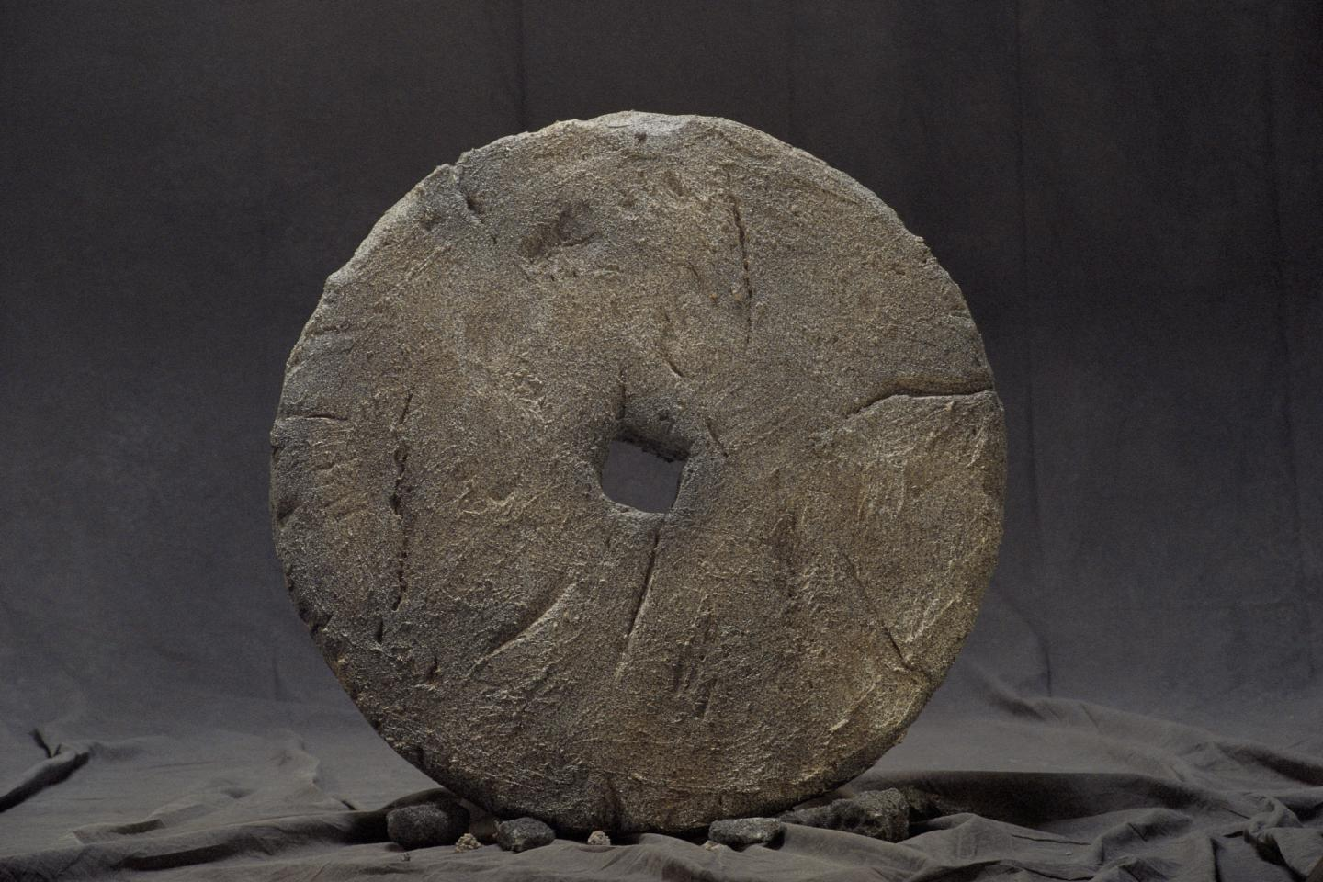
Ancient Mesopotamia: Either Religion or to Sustain
Artisans played an important role in the culture of the Mesopotamian people.
They made everyday useful items like dishes, pots, clothing, baskets, boats, and weapons.
They also created works of art meant to glorify the gods and the king.
The most common material for Mesopotamian artists was clay. Clay was used for pottery, monumental buildings, and tablets used to record history and legends.
The Mesopotamians developed their skills in pottery over thousands of years. At first they used their hands to make simple pots.
Later they learned how to use a potter's wheel. They also used high temperature ovens to harden the clay.
They learned how to make different shapes, glazes, and patterns. Soon their pottery turned into works of art.

Slide 3
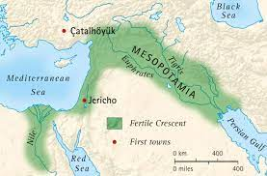
Geographical Region
Mesopotamia now known as Iraq was once called Sumer (Southern M) during the Early Bronze Age.
Despite the earliest recorded historical events only dating back to around 2900 BCE, scholars today think that Sumer was first inhabited by people called the Ubaidians sometime between 4500 and 4000 BCE.
Bordering along the Persian Gulf was the city of Eridu, regarded as the first city in the world. It was home to three cultures
that became integrated due to their shared geographical position
– the fishermen, the Semitic speaking nomadic shepherds, and the Ubaidian farmers.
These three groups were all specialists in food production which eventually led to a surplus of food that could be stored.

Slide 4
The Halaf Culture 6500–5500 B.C.E
A farming society emerged in Northern Mesopotamia and Syria
shared a common culture and produced potteries with geometric designs, that is among the finest ever made in the Near East.
This culture is known as Halaf, after the site of Tell Halaf in northeastern Syria where it was first identified.
The Halaf potters used different sources of clay from their neighbours and achieved outstanding elaboration and elegance of design with their superior quality ware.
Some of the most beautifully painted polychrome ceramics were produced toward the end of the Halaf period.

Slide 5
Unlike hunter-gatherers, this ability to produce and store food meant that instead of constantly migrating in search of resources, people could settle in one place. With the surplus of food came an increase in the population, which in turn required a labor force that could produce goods, services, crafts, and art for the inhabitants.
During early Sumerian period, the cuneiform writing was developed.

Slide 6
Art of the Ubaid Period
From this language, as well as other ancient Mesopotamian artifacts such as pictograms, we can deduct that there was an abundance of Mesopotamian art traditions.
The art of Mesopotamia from this period is recognizable by the distinctive painting technique applied to the pottery. These zig-zag and circular patterns were created in a domestic capacity on a slow wheel. It would eventually become a popular style throughout the region. It was during this early period that farmers first established a settlement to attend to their agricultural practices.

Slide 7
The Uruk Period
During this period of transition toward the Uruk period from the Ubaid period, the focus shifted from domestic slow wheels to works that were created large-scale on fast wheels by groups of specialist artists and were unpainted. During this period of economic growth in the region, many new cities began to be developed
Mesopotamian artifacts of the Uruk period have been discovered over a large range of land – from Central Iran to the Mediterranean Sea and all the way to the Taurus Mountains of Turkey. The Uruk culture had a great influence on surrounding areas due to its spread via the traders of Sumer,

Slide 8
Warka vase from all angles – Uruk period
During this period cities were mostly theocratic, meaning they believed a deity ruled over all of society and that a priest was god’s representative of earthly matters.
These holy rulers would also call on a council of male and female elders for assistance. This political model would go on to influence the pantheon of gods structure of the later Sumerian period. This was a period of peace, with no walls around the cities, indicating a lack of need for defense, and there were no soldiers or institutionalized violence.

Slide 9
Tablet V– Epic of Gilgamesh
Enmebaragesi of Kish is the first recorded king of this region and was mentioned in the Epic of Gilgamesh from around 2100 BCE, leading some scholars to suggest that Gilgamesh might once have been a king of Uruk himself.

Slide 10
The Chalcolithic Era
The pottery produced during the Ubaid period was made on slow wheels at home and was highly decorated. Mesopotamian artists created jars, bowls, and vases with fired clay and painted decorative and abstract designs – a style that spread throughout the region. Ceramics in the following period were produced with much greater ease and at greater volume thanks to the invention of the potter’s wheel.

Slide 11
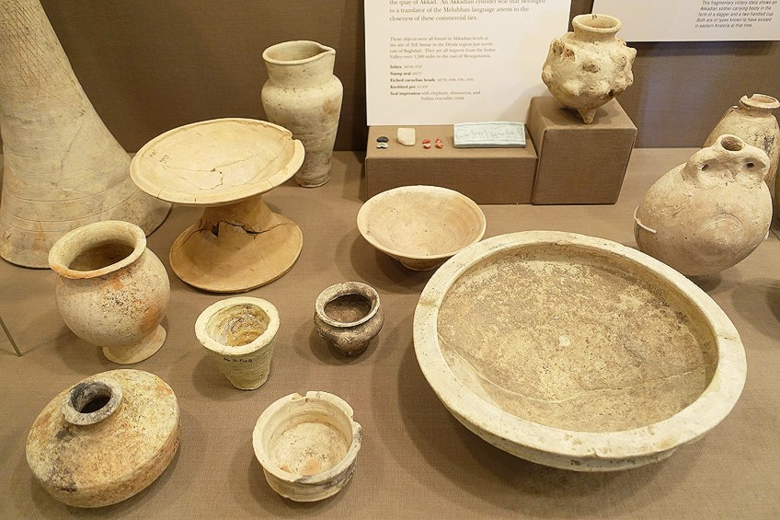
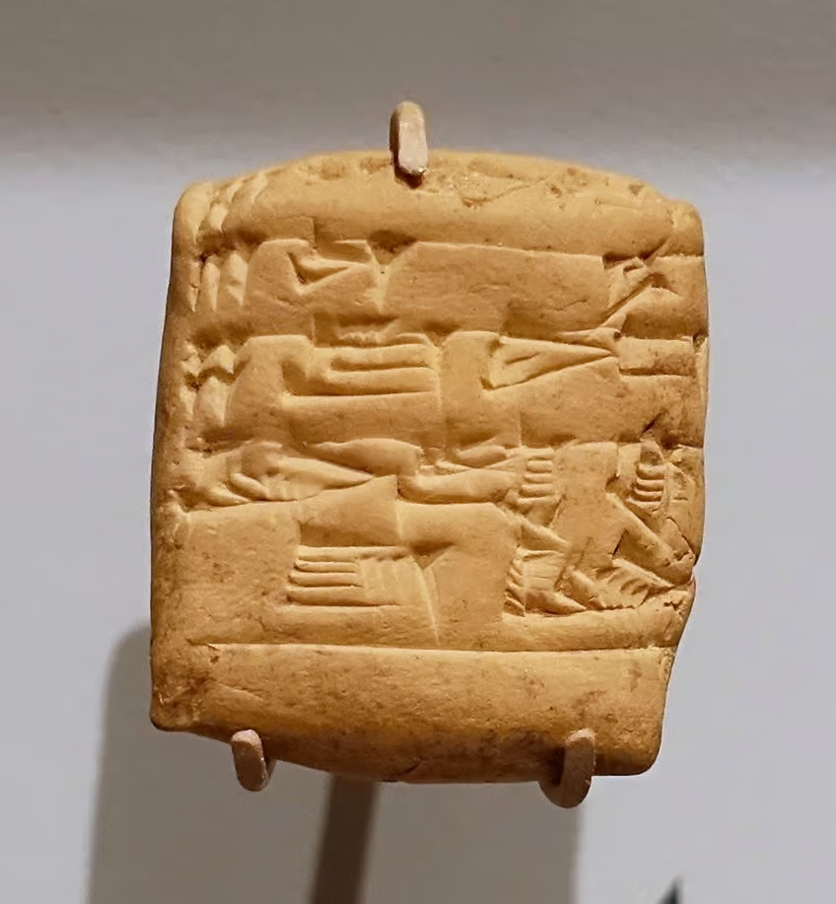
The Akkadian Empire (2270 to 2154 BCE) And Ur III
Akkadian period saw a continuation of unpainted pottery
During the Third Ur Dynasty, unpainted ceramic objects were still being created, yet in more elaborate forms, creating vessels out of clay for storing liquids, as well as flowerpots and cake stands. Clay tablets were also produced to keep records by writing on them with styluses made from reed.

Slide 12
Babylonian Ceramics
Ceramics produced during this period indicates a marked return to the use of abstract patterns painted on the surface of the pottery, as well as a further increase in the array of forms available for various purposes, both practical and aesthetic. Ceramic Mesopotamian artifacts from this period such as jars, vases, and goblets have been found with remnants of abstract painting on the clay exterior.

Slide 13
Pottery in Egypt: Pre-Dynastic
ancient Egyptians excelled at pottery. This clay pot is an artifact from ancient Egypt. It even emerged during the predynastic period, the earliest period in recorded Egyptian history. Pottery was already being created during what is known as the Naqada II period (3500-3200 BCE), long before the pyramids were built.

Slide 14
Pottery and Economic Functions
Originally, pottery was not regulated through workshops or the state economy. It later became as such during dynastic Egypt. Noticing a variation, famed Egyptologist Petrie noted that pottery in ancient Egypt was originally made for functional reasons rather than decorative purposes. It was a valuable commodity extant in the Old Kingdom. Patron and client relationships were reinforced through the exchange of pottery labor.
The ancient art can be divided into two categories, Nile Clay pottery, and Marl Clay pottery. Nile clay pottery, also known as the Nile silt ware, is the most common vein of pottery. This vein of pottery has a red-brown color that is produced after being fired and was commonly used for utilitarian purposes. The Marl clay, on the other hand, is usually polished to give a lustrous look.

Slide 15
Predynastic pottery was of fine quality. During the Badarian period, pottery was produced without the use of a pottery wheel. Experts have concluded that other than the wheel, there are two methods to prepare vessels: the coil and smoothen technique as well as placing mud in a hole and smoothing the surface. Once prepared, the vessels were then burnished into a lustrous finish and fired in kilns, leaving a black upper section and lower, deep red, or brown section. It is worth noting that in most of Egypt, the master-potter is always a man, except in Nubia.
The potter’s vision for his piece’s design and usage affect the kind of clay used. The types of clay are classified into four main categories; earthenware clay, stoneware clay, ball clay, and porcelain clay.

Slide 16
Pot with depiction of a galloping horse from the 18th Dynasty
Glazed vessel made with Nile clay

Slide 17
Cylinder vessel made with Marl clay – 1st dynasty
Painting of Nile clay being gathered

Slide 18
Naqda II pottery – elephants on the rim
Shaping
There were five different techniques for shaping clay in ancient Egypt:
by hand
using a rotatable pilaster
using a potter’s wheel operated by one of the potter's hands
using a mould
on a rapidly spinning potter's wheel, operated by an assistant or the potter's foot.

