Slide 1
Neighbours of
Ancient Rome
Soma Marik
Semester II 2020

Slide 2
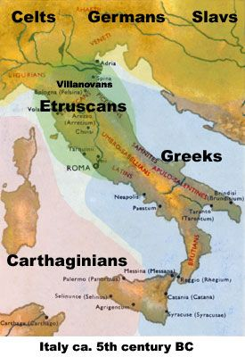
Neighbours

Slide 3
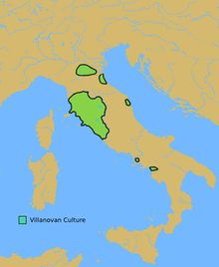
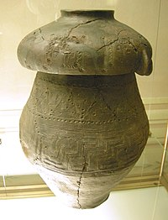
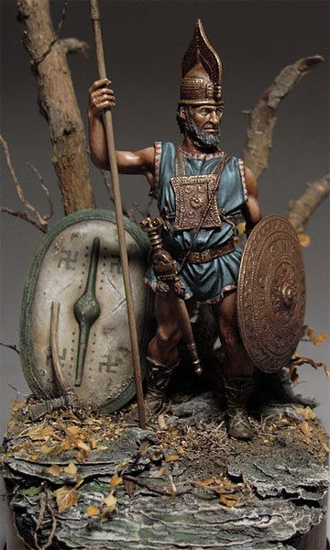
Neighbouring Cultures
The Villanovan culture (c. 900 BCE – 700 BCE) was the earliest Iron Age culture of Central Italy and Northern Italy in the Po valley
Giving way in the 7th century BCE to an increasingly orientalizing culture influenced by Greek traders

Slide 4
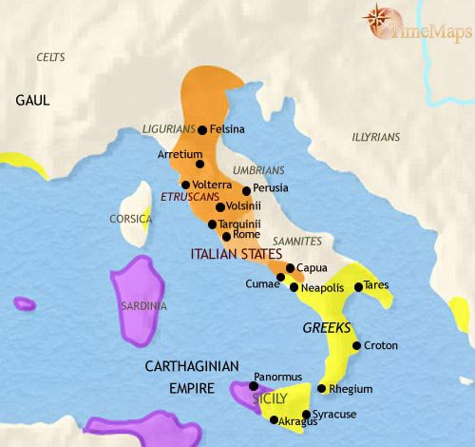
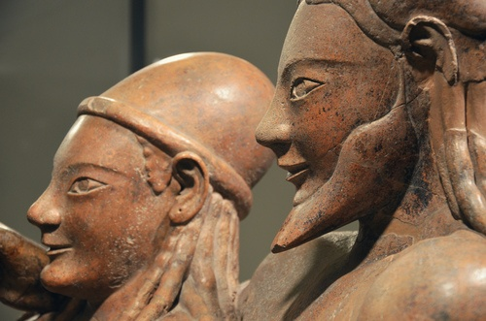
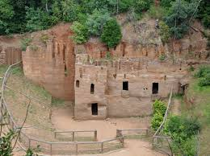
Etruscan civilization (c.800-400 BCE)
a powerful and wealthy civilization of ancient Italy in the area corresponding roughly to Tuscany, south of the Arno river.
As distinguished by its unique language, this civilization ultimately assimilated into the Roman Republic in the late 4th century BCE with the Roman--Etruscan Wars.
Romans learned how to build the arch from the
Etruscans

Slide 6
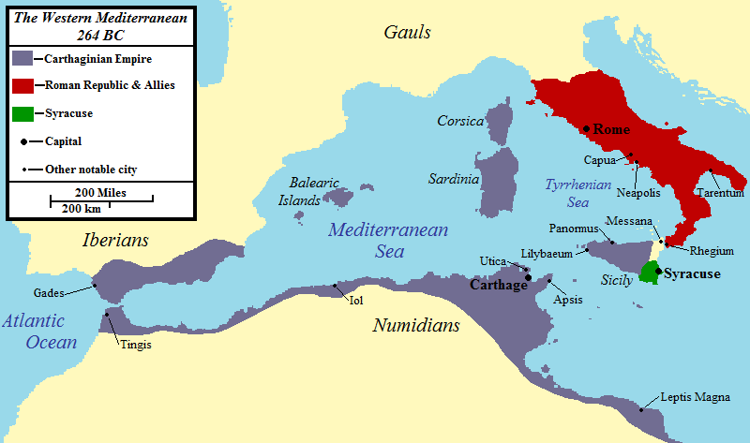
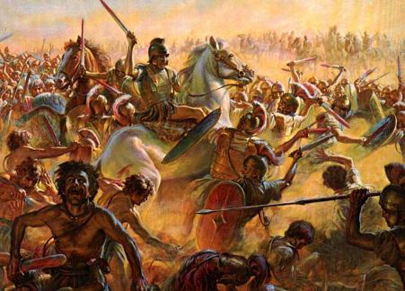
Carthaginians
Carthage was the Phoenician state in North Africa
including, during the 7th–3rd centuries BCE, its wider sphere of influence
known as the Carthaginian Empire
extended over much of the coast of Northwest Africa
as well as encompassing substantial parts of coastal Iberia
and the islands of the western Mediterranean Sea

Slide 7
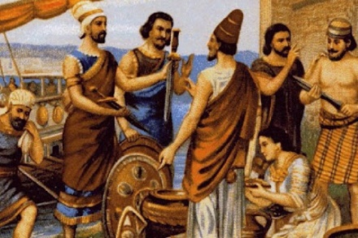
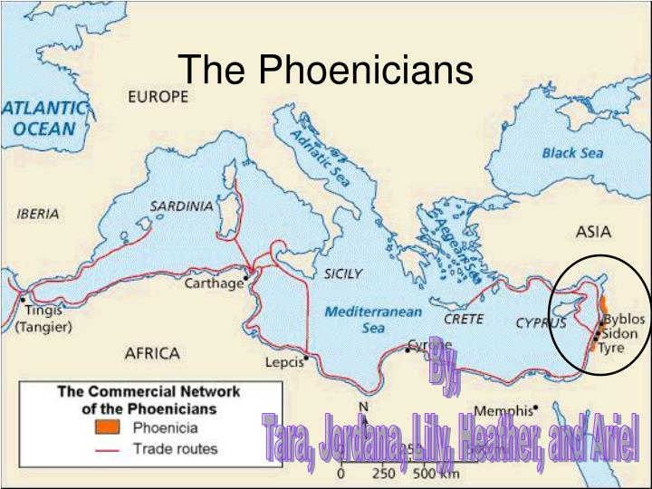
Phoenicians
Phoenicians founded Carthage in 814 BCE
Initially a dependency of the Phoenician state of Tyre, Carthage gained independence around 650 BCE
established its political domination over other Phoenician settlements throughout the western Mediterranean
lasting until the end of the 3rd century BCE
At the height of the city's prominence, it served as a major hub of trade, with trading stations extending throughout the region.
Carthage was on hostile terms with the Greeks in Sicily and with the Roman Republic
tensions led to a series of armed conflicts known as the Sicilian Wars (c. 600–265 BCE) and the Punic Wars (264–146 BC) respectively.

