Slide 1
Goals of Psychodynamic therapy

Slide 2
All forms of Psychotherapy aim at: treating, healing or being curative.
“Normalcy” not a goal of therapy, because it is impossible to be perfect . It is a goal we are constant trying to achieve.
Freud: Capacity to work and love; also the capacity to relax and have fun.
Goals:

Slide 3
1. Symptom alleviation
Specific symptoms , like phobia etc;
More vague symptoms, like what is the meaning of life etc.
Some to be treated with Psychotherapy,
Psychopharmacology.
Psychodynamic therapy : treats symptoms that are woven into the character of the patient.

Slide 4
Unlocking the developmental impasse or fixations
Capacity to develop object relations
Separation and individuation;
Object constancy;
Self- constancy and capacity to be alone;
Reliable gender identity;
Developmental impasse: Fixation at the phallic-oedipal or phallic narcissistic stage.

Slide 5
Goals: contd,
Increasing self-esteem;
Modifying the super ego and ego ideal;
Identity changes and consolidation;
Improve coping ability and the defenses;
Increase continuity with the past;
Increase in fullness of experiences;
Increase in self- analysing capacity;
Increase in self-soothing capacity;
Improved interpersonal relations;
Sexuality;
Increase in creativity

Slide 6
agenda
INTRODUCTION 3
PRIMARY GOALS 4
AREAS OF GROWTH 5
TIMELINE 10
SUMMARY 13

Slide 7

introduction
At Contoso, we empower organisations to foster collaborative thinking to further drive workplace innovation. By closing the loop and leveraging agile frameworks, we help business grow organically and foster a consumer-first mindset.​

Slide 8
primary goals

Slide 9
quarterly performance

Slide 10
areas of growth
 | B2B | SUPPLY CHAIN | ROI | E-COMMERCE
Q1 | 4.5 | 2.3 | 1.7 | 5.0
Q2 | 3.2 | 5.1 | 4.4 | 3.0
Q3 | 2.1 | 1.7 | 2.5 | 2.8
Q4 | 4.5 | 2.2 | 1.7 | 7.0

Slide 11
RICHARD BRANSON
“Business opportunities are like buses.
There's always another one coming.”

Slide 12
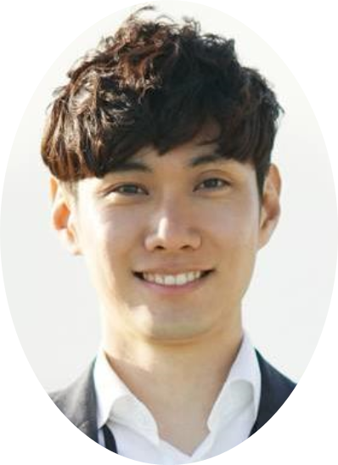
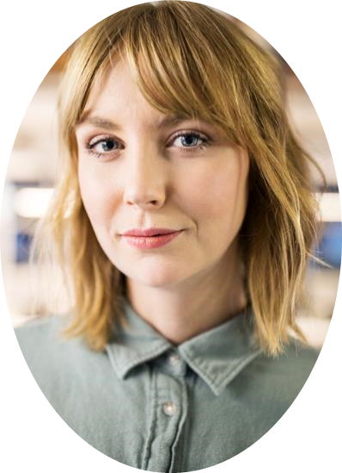
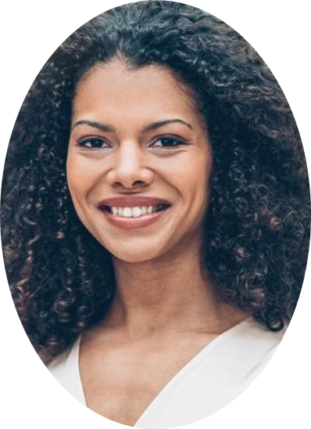
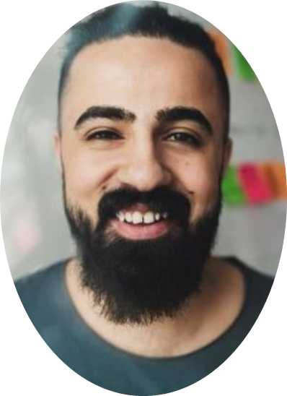
meet our team
TAKUMA HAYASHI
MIRJAM NILSSON​
FLORA BERGGREN​
RAJESH SANTOSHI
president
chief executive officer
chief operations officer
vp marketing

Slide 13
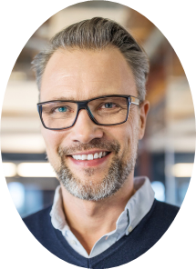
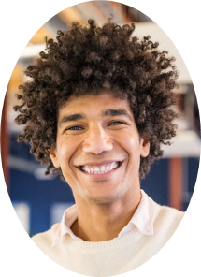


meet our extended team
TAKUMA HAYASHI
MIRJAM NILSSON​
FLORA BERGGREN​
RAJESH SANTOSHI
president
chief executive officer
chief operations officer
vp marketing
GRAHAM BARNES
ROWAN MURPHY
ELIZABETH MOORE
ROBINE KLINE
vp product
SEO strategist
product designer
content developer

Slide 14
plan for product launch
deploy strategic networks with compelling e-business needs
PLANNING
synergise scalable e-commerce
MARKETING
disseminate standardised metrics
DESIGN
coordinate e-business applications
foster holistically superior methodologies
LAUNCH
STRATEGY

Slide 15
timeline
NOV 20XX
  disseminate standardised metrics
SEP 20XX
  synergise scalable e-commerce
JAN 20XX
  coordinate e-business applications
MAR 20XX
  foster holistically superior methodologies
MAY 20XX
  deploy strategic networks with compelling e-business needs

Slide 16
areas of focus
B2B MARKET SCENARIOS
Develop winning strategies to keep ahead of the competition
Capitalize on low-hanging fruit to identify a ballpark value
Visualise customer directed convergence​
CLOUD-BASED OPPORTUNITIES
Iterative approaches to corporate strategy
Establish a management framework from the inside

Slide 17
how we get there
ROI
NICHE MARKETS
SUPPLY CHAINS
Envision multimedia-based expertise and cross-media growth strategies
Visualise quality intellectual capital
Engage worldwide methodologies with web-enabled technologies
Pursue scalable customer service through sustainable strategies
Engage top-line web services with cutting-edge deliverables
Cultivate one-to-one customer service with robust ideas
Maximise timely deliverables for real-time schemas

Slide 18

summary
At Contoso, we believe in giving 110%. By using our next-generation data architecture, we help organisations virtually manage agile workflows. We thrive because of our market knowledge and great team behind our product. As our CEO says, "Efficiencies will come from proactively transforming how we do business."​

Slide 19
thank you
mirjam nilsson
mirjam@contoso.com
www.contoso.com

