Slide 1
LGBTQ & Live-In Relationships

Slide 2
LGBTQ!!??

Slide 3
The gender unicorn

Slide 4
Types of Sexual Orientation

Slide 5
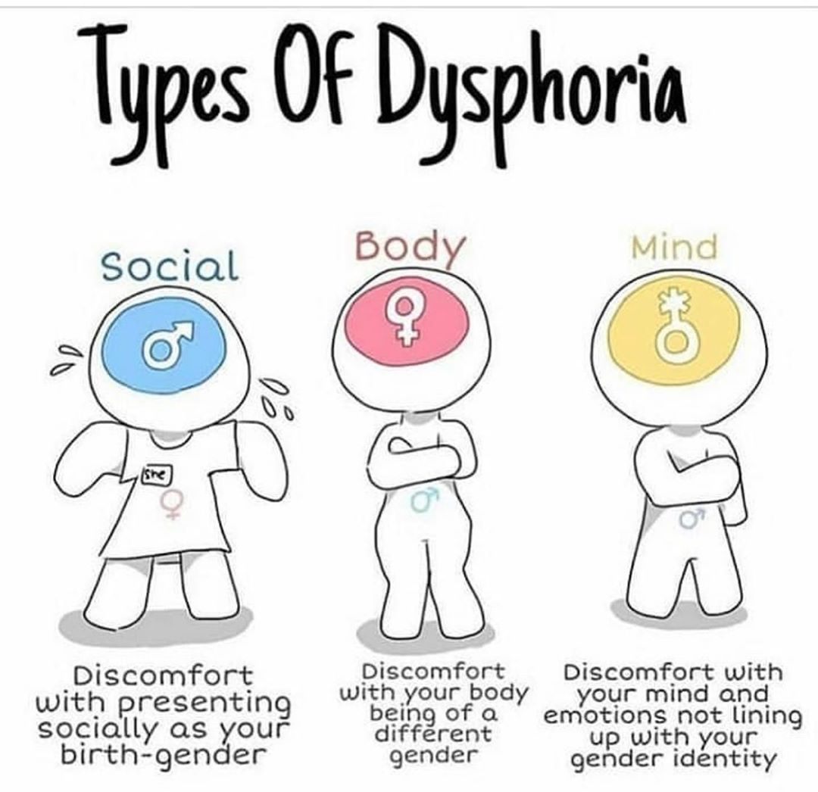
Gender Identity
Transgender: A transgender person (often abbreviated to trans person) is someone whose gender identity or gender expression does not correspond with the sex they were assigned at birth.

Slide 6
Lesbian: A lesbian is a homosexual woman or girl. The word is also used for women in relation to their sexual identity or sexual behavior, regardless of sexual orientation, or as an adjective to characterize or associate nouns with female homosexuality or same-sex attraction.
Gay: Gay is a term that primarily refers to a homosexual person or the trait of being homosexual. While scant usage referring to male homosexuality dates to the late 19th century, that meaning became increasingly common by the mid-20th century.
Bisexual: Bisexuality is a romantic or. sexual attraction or behavior toward both males and females or to more than one gender.
Transgender: A transgender person (often abbreviated to trans person) is someone whose gender identity or gender expression does not correspond with the sex they were assigned at birth.
Queer: Queer is an umbrella term for people who are not heterosexual or cisgender.

Slide 7
Live-In Relationships!!

Slide 8
Live-in relationship is defined as “an arrangement of living under which the couples who are unmarried live together to conduct a long-term relationship similarly as in marriage.

Slide 9
Pros & Cons of live-in relationships

Slide 10
Thank you!

