Slide 1
The Sociological imagination a brief introduction
Anasua Chatterjee (PhD, Sociology, JNU, New Delhi)
Assistant Professor, Department of Sociology, RKSMVV

Slide 2
Sociological imagination
What does it mean to think sociologically?
The sociological perspective involves:
breaking free from routines.
and put things in wider context.
Let us try to understand this with an example.

Slide 3
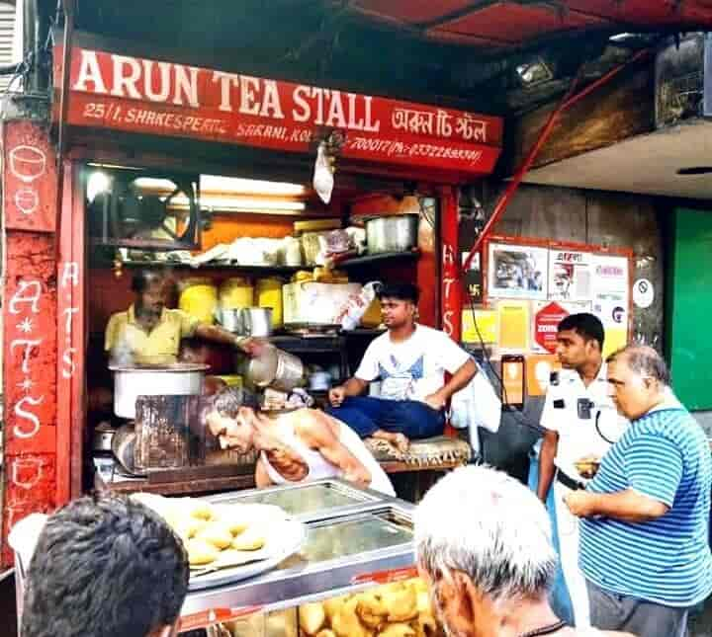
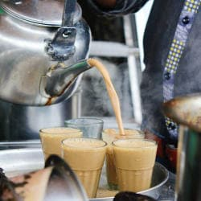
Tea drinking
A personal routine
A site of social get togethers: the ritual of ‘chayer adda’, the ‘chayer dokan’, ‘canteen-er cha’ and so on.
Tea as a site of fixing social identities; tea as lifestyle.

Slide 4
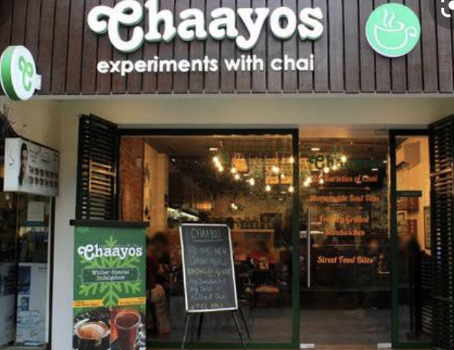
Tea drinking
Individual drinking tea caught in a complex web of historical, social and economic relations (British introduced tea drinking in India – nationalist constructions around tea drinking – labour exploitation in tea plantation farms).
Re-invention of tea as a global drink: example: ‘chai-tea’, Chaayos, Chai Point

Slide 5
Summing Up
SI helps us understand the relationship between an everyday act/event and wider society.
This helps the sociologist come up with structural explanations of events.
Elaborated by C. Wright Mills in The Sociological Imagination published in1959
Link: https://www.gradesaver.com/the-sociological-imagination/study-guide/summary-chapter-1

Slide 6
Thank you

